Slide 1


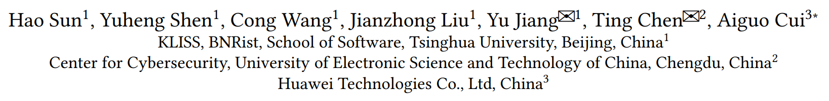



HEALER: Relation Learning Guided Kernel Fuzzing
Notes:
Hello, everyone. My name is Sun Hao. I’m a MSC student in Tsinghua university, doing research about kernel fuzzing. I care about security of Linux most.
Today, I’m going to introduce you a method to improve the quality of generated inputs for kernel fuzzer, called relation learning. Hope this method can give you some inspirations in your research domain.

Slide 2


Outline
Coverage Guided Kernel Fuzzing
Motivation
Relation Learning
Implementation
Evaluation
Future Work
1
Notes:
I’ll first talk a little about coverage guided kernel fuzzing. Then, discuss the motivation behind my idea and introduce the design in details. Finally, I’ll share some implementation details, the evaluation results, and talk about the future work.

Slide 3
Coverage-Guided Kernel Fuzzing

Slide 4
Fuzzing 101
Source Code
Fuzzable Program
Coverage Feedback
Saver
Fuzz Driver
Random Input
Interesting Path
Mutator
Select
Corpus
Notes:
Here is an very brief workflow of fuzzing in user space program. First, we compile the source code and fuzz drive with code instrumented so that we have a fuzzable program. Then, fuzzer select and mutate the data in corpus, feeding the generated inputs to the target program. Finally, fuzzer monitor the execution process, collect and analyze the feedback. Based on feedback, fuzzers refine the corpus continuously. This design works very well in user-space. However, things become different and difficult when it comes to the kernel-space due to the complexity of kernel itself.

Slide 5
Coverage Guided Kernel Fuzzing
Kernel Source
Sanitizer Configs
Corpus
Refine
Feedback
Target
Kernel
Call Sequences
Syscall
Description
Mutation
Input
Executor
META
Gen
Call Sequence
Crash
Report
Repro
Prog
Notes:
Overall, the workflow of kernel fuzz can be summarized as this.
First, we compile the kernel with sanitizer, coverage config.
Then We give kernel fuzzer the corpus (call sequences), the syscall description, some other meta information.
Then fuzzer generate the input call sequences, feed the input to executor, the executor issues the syscalls based on the input. The fuzzer then refines its corpus or META based on the feedback, save crash reports and repro progs if kernel crashed.
That’s how coverage guided kernel fuzzing works.

Slide 6

Coverage Guided Kernel Fuzzing: Input
Call Sequence
sock_fd = socket(AF_INET, SOCK_STREAM, 0)
bind(sock_fd, &addr, sizeof(addr)
listen(sock_fd, …)
accept(sock_fd, &peer_addr, &size)
Input
Structure and partial semantic aware
Setup kernel state
Reach deep kernel logic
Notes:
The solution adopted by most kernel fuzzers is call sequence. Fuzzer generate or mutate a sequence of calls, the parameters of each call satisfy the structural and partial semantic constraints. Former calls setup required kernel state for the latter calls, so that each call can reach deep kernel logic instead of being rejected early.
However, we need some meta information about syscalls themselves in this solution. For example, parameter number of a call and the accurate type of each parameter so that we can generate above sequence. So the problem is how do we provide these information to fuzzers?

Slide 7
Syscall Description Language: Syzlang
resource sock[fd]
resource sock_in[sock]
socket$inet(domain const[AF_INET], type flags[socket_type], proto int32) sock_in
accept$inet(fd sock_in, peer ptr[out, sockaddr_in], peerlen ptr[inout, len[peer, int32]]) sock_in
bind$inet(fd sock_in, addr ptr[in, sockaddr_in], addrlen len[addr])
listen(fd sock, backlog int32)
Rich type, type constructors
Semantic modifier
Encoding accurate structure, partial semantics
Notes:
Therefore, people start to design domain specific language (DSL) to resolve this.
Syzlang is used most widely.
It has very rich type and type constructors, so that we describe the input structure accurately.
It also supports encoding partial semantics. For example, the const type, the flags type here.
The length type here indicates that the `peerlen` is the byte size of the `peer`.
The `sock_in` here is a resource type, I’ll talk about this latter.
With Syzlang, we can provide fuzzer with accurate input structure and partial semantics of syscalls.

Slide 8
Syscall Description Language: Syzlang
resource sock[fd]
resource sock_in[sock]
socket$inet(domain const[AF_INET], type flags[socket_type], proto int32) sock_in
accept$inet(fd sock_in, peer ptr[out, sockaddr_in], peerlen ptr[inout, len[peer, int32]]) sock_in
bind$inet(fd sock_in, addr ptr[in, sockaddr_in], addrlen len[addr])
listen(fd sock, backlog int32)
Resource Type
Value, output from other calls
`resource A[B]` => A is subtype of B
Call Specialization
Specialize partial arguments
Format: call$name
Notes:
We need to focus on two features of Syzlang because we’ll use them in the algorithm.
The first one is resource type. Resource type indicates that the value of that parameter must be the output from other calls and is some kind of resource in the kernel. For example, file descriptor, socket.
Resource type supports inheritance, which indicates that resource A can be used as resource B, A is subtype of B.
For example, `sock_in` here inherits `sock`, the return value of `socket$inet` can be used as input for `listen`.
Another feature is call specialization. This feature allows us to specialize partial parameters of a call.
For example, the first parameter of `socket$inet` is specialized to a const value.

Slide 9
Motivation
Notes:
Now, let’s talk about the problem we want to solve.

Slide 10


Call Combination
For a set of syscalls { $S_{0}$, $S_{1}$, $S_{2}$, … $S_{n}$ }
Generate a sequence of calls [ $C_{0}$, $C_{1}$, $C_{2}$, …]
For sequence [ $C_{0}$, $C_{1}$], how to choose the next system call?
Random? Optimized strategy?
What is the idea behind the strategy ?
7
Notes:
For kernel fuzzer, a core problem is choosing call combination.
That means, for a set of syscalls, fuzzer need to generate sequence of calls.
From now on, I’ll call a system call as `S`, a actual call to the system call as `C`.
This problem can be described as, for a given sequence, how to choose the next system call?
Should we choose randomly or use a better optimized strategy?
What is the idea behind the strategy if we use it?

Slide 11
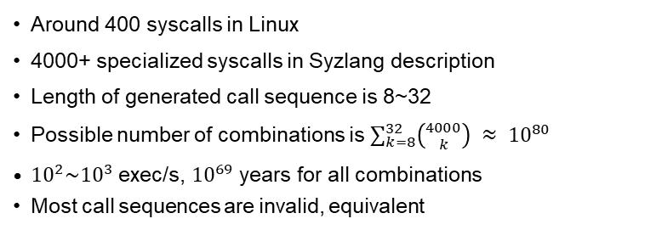
Problem: Countless Call Combinations
Around 400 syscalls in Linux
4000+ specialized syscalls in Syzlang description
Length of generated call sequence is 8~32
Possible number of combinations is $\sum_{k=8}^{32}{\left({4000 \atop k}\right)} ≈ {10}^{80}$
${10}^{2}\sim {10}^{3}$ exec/s, ${10}^{69}$ years for all combinations
Most call sequences are invalid, equivalent
Need better strategy to choose call combination, rather than random.
8
Notes:
Let’s first discuss the problem of random choosing.
The Linux kernel has almost 100 syscalls. Syzlang description of Syzkaller contains more than 4000 specialized syscalls. Typically, the length of generated call sequence is from 8 to 32.
Therefore the number possible combination can be calculated with this formular, which almost equals to …
Current kernel fuzzer can execute 100 to 1000 call sequences each second, it would take almost xx years to execute all the possible combinations. However, most sequences are invalid, equivalent with each other, which means fuzzer would waste most time executing bad inputs if use random choosing strategy.
Therefore, we need better way to choose call combination, rather than random.

Slide 12
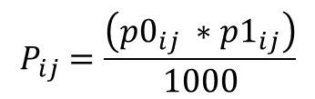
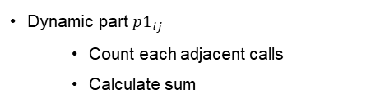
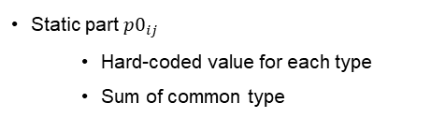
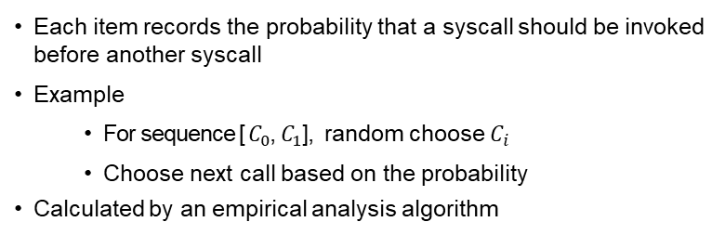
Choice Table Of Syzkaller
Each item records the probability that a syscall should be invoked before another syscall
Example
For sequence [ $C_{0}$, $C_{1}$], random choose $C_{i}$
Choose next call based on the probability
Calculated by an empirical analysis algorithm
$$P_{ij}=\frac{\left(p0_{ij} ∗p1_{ij}\right)}{1000}$$
Static part $p0_{ij}$
Hard-coded value for each type
Sum of common type
Dynamic part $p1_{ij}$
Count each adjacent calls
Calculate sum
Too
Empirical
9
Notes:
Syzkaller is the state of the art kernel fuzzer and developed by Google, used very widely.
It uses a choice table to guide call selection. Each item of its table records the probability that a syscall should be invoked before another. For example, for sequence .., it first random choose a, then choose the next call based on the probability. Therefore, the quality of generated call combination is mostly decided by the quality of the probability value. However, the probability value itself is calculated by an empirical analysis algorithm. It contains two parts. The first part is static part. It find the common type of two calls, each type has a hard coded value, the static part simply add these value of common type. The dynamic part count each adjacent calls in the corpus. The more two adjacent calls appears, the bigger the value is. The algorithm can be summarized as this formular. However, this method is too empirical, not mention its dynamic part relies on the quality of corpus.

Slide 13
Observation: Influence Relation
sock_fd = socket(AF_INET, SOCK_STREAM, 0)
Create socket inside the kernel
Former calls setup related kernel states
The latter calls can be influenced by those states
Execution path of the latter call changed due to the internal kernel state modified by the former call
bind(sock_fd, &addr, sizeof(addr)
Bind address to the socket
listen(sock_fd, …)
Mark socket
accept(sock_fd, &peer_addr, &size)
Influence relations exist between two system calls if the execution of a former can alter the latter’s execution path.
Notes:
Let’s now focus on a high quality sequence and try to figure out why its quality is high.
The first call `socket` creates corresponding socket data structure inside the kernel and returns a handle to user-space. Then, the second call `bind` bind a address to that socket though the returned handle. The call `listen` mark that socket can accept connection now, and finally, the last call `accept` accept the connection from the created socket via the return handle. As we see, each former call setup related kernel state for the latter call. For example, `bind` bind a address to the socket so that listen can really work. The latter call can be influenced by those state. For example, call `listen` would return early without binding valid address. The execution path of the latter call changed due to internal kernel state, which’re modified by the former calls.
Therefore, as we can see, influence relations exist between two system calls if the execution of a former can alter the latter’s execution path and the reason behind it is internal state.

Slide 14
Observation: Guide with Influence Relation
sock_fd = socket(AF_INET, SOCK_STREAM, 0)
Influence relation exists between calls
Some execution paths of one call may only be executed in certain kernel states
Insert more system calls that have influence relations before the target system call so that we can trigger different kernel states and allow each system call to enter deep execution paths
Create socket inside the kernel
bind(sock_fd, &addr, sizeof(addr)
Bind address to the socket
listen(sock_fd, …)
Mark socket
accept(sock_fd, &peer_addr, &size)
The number of invalid test cases and the size of the search space can be reduced significantly by taking relations between system calls into consideration.
Notes:
Also, influence relation exists between most calls on kernel, not just calls in the example.
Some execution path of one may only be executed in certain kernel states.
Again, for example, `listen` may return early without binding address, accept may return error without marking listen.
Therefore, fuzzer should insert more calls ….
On the other head, …
We should decrease the probability that insert calls that do not have influence relations before the target system call.
With this idea, the number of invalid test cases and the size of the searching space can be reduced significantly.
Therefore, we propose to use influence relation to guide the call generation.

Slide 15
Our Idea
Guide Kernel Fuzzing with Relation Learning
Learn the influence relations dynamically, iteratively
Guide generation and mutation with learned relations
Increase the quality of inputs, speedup the fuzzing process
12
Notes:
In this work, we propose to guide kernel fuzzing with relation learning.
First, we need to learn the influence relations dynamically, iteratively.
Then, we guide the gen&mut with learned relations so that we can inc..

Slide 16
HEALER: Relation Learning
Notes:
Now, let’s talk about how to learn the relations and how to use them.

Slide 17
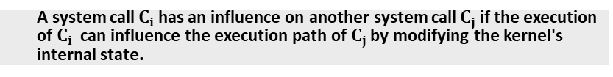
Definition
Relation
A system call $C_{i}$ has an influence on another system call $C_{j}$ if the execution of $C_{i}$can influence the execution path of $C_{j}$ by modifying the kernel's internal state.
Relation is about influence of execution path
The reason behind relation is kernel state
13
Notes:
We give relation a brief definition.
Relation exist between tow calls if …
Here we need to remember two things: first, relation is about influence of the execution paths; Second, the reason behind relation is kernel state.

Slide 18
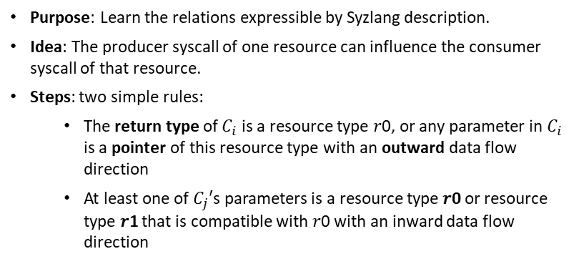
Static Learning
Purpose: Learn the relations expressible by Syzlang description.
Idea: The producer syscall of one resource can influence the consumer syscall of that resource.
Steps: two simple rules:
The return type of $C_{i}$ is a resource type 𝑟0, or any parameter in $C_{i}$ is a pointer of this resource type with an outward data flow direction
At least one of $C_{j}′$s parameters is a resource type 𝑟0 or resource type 𝑟1 that is compatible with 𝑟0 with an inward data flow direction
Notes:
Now, let’s talk about how to learn the relation step by step.
The first part of relation learning is static learning.
The purpose here is to learn …
The idea behind the algorithm is .
The static learning only contains two simple rules:
First if ..
And if
Then we can say C_i can influence the execution path of C_j

Slide 19
Static Learning
socket$inet(domain const[AF_INET], type flags[socket_type], proto int32) sock_in
bind$inet(fd sock_in, addr ptr[in, sockaddr_in], addrlen len[addr])
socketpair(domain flags[domain], type flags[socket_type], proto int32, fds ptr[out, sock_pair])
bind$inet(fd sock_in, addr ptr[in, sockaddr_in], addrlen len[addr])
resource sock_in[sock]
socket$inet(domain const[AF_INET], type flags[socket_type], proto int32) sock_in
listen(fd sock, backlog int32)
Notes:
Here is an example.
The return of socket$inet is sock_in, we know it is a resource type and the first input parm of bind is ..
Therefore, we can say s has influence relation with b.
The second example shows another case. The last param of sockpair is an pointer type with outward direction, and the underlining type is resource type. It means this calls can also output resource type. Therefore, again, s have …
Here is the last example. We known sock_in is subtype of sock. And socket return sock_in, listen takes sock as input.
We can also say s has …
We also need to take care of some Compound types, such as struct, union. This can be down applying above rules recursively.

Slide 20
Dynamic Learning: Minimization
Purpose: Only analyze calls that contribute to new coverage.
Idea: Remove one call as long as the coverage keeps the same.
Steps: For sequence P and its coverage:
Extract the subsequence 𝑝′ for call 𝐶𝑖 that has not yet been included in the other minimal sequences
Remove each call 𝐶′ before 𝐶𝑖 in 𝑝′
If coverage keeps same, commit the change
Example
For [memfd_create, write, fcntl, mmap], with [cov0, cov1, cov2, cov3], cov3 contains new coverage
`write` is removed, the final sequence is [memfd_create, fcntl, mmap]
Notes:
Ok, that’s all about static learning. Let’s focus on dynamic learning now.
The first part of dynamic learning is sequence minimization.
The input sequences are generated by fuzzer and may contain redundant calls and we only want to analyze calls that contribute to new coverage.
So we minimize the sequence first.
The idea behind minimization is keep remove calls as long as the coverage keeps the same.
We can use an example to demonstrate this.
For sequence […], with coverage [….], suppose cov3 contains new cov.
The algorithm will first try to remove fcntl, but it will soon figure out we’re losing new coverage, so the change won’t be committed. Then, it tries to remove write and this time, the algorithm figures out the coverage keeps same. Therefore, the change is committed and the minimization succussed once.
The final output of minimization of this example would be …

Slide 21
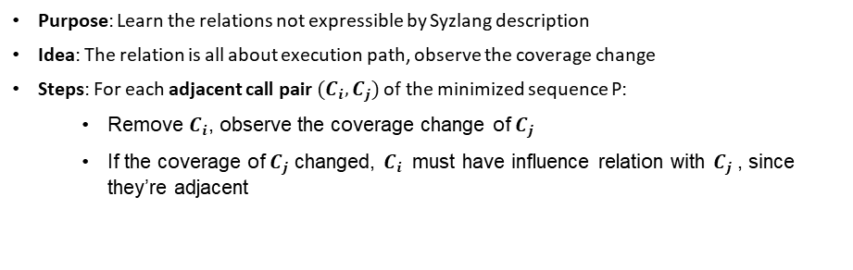
Dynamic Learning
Purpose: Learn the relations not expressible by Syzlang description
Idea: The relation is all about execution path, observe the coverage change
Steps: For each adjacent call pair $(C_{i}, C_{j})$ of the minimized sequence P:
Remove $C_{i}$, observe the coverage change of $C_{j}$
If the coverage of $C_{j}$ changed, $C_{i}$ must have influence relation with $C_{j}$, since they’re adjacent
Learn relations iteratively
Notes:
Based on the minimization, the dynamic learning tries to learn the relations not expressible by Syzlang description.
The idea behind dynamic learning is that the relation is all about execution path, let’s just observe the coverage change. Also, the process of algorithm is pretty straightforward too. For each adjacent call pair (..) of the minimized sequence, it first removes C_i, and execute the changed sequence and observe the coverage of C_j, if …
That’s it. The idea is quite easy to understand.
However, the implementation requires more efforts than you think.
For example, we need to calibrate the coverage several time to reduce the impact of uncertainty of the kernel.
We also need to implement many infrastructures to support the learning algorithm.
We’ll take it latter.

Slide 22
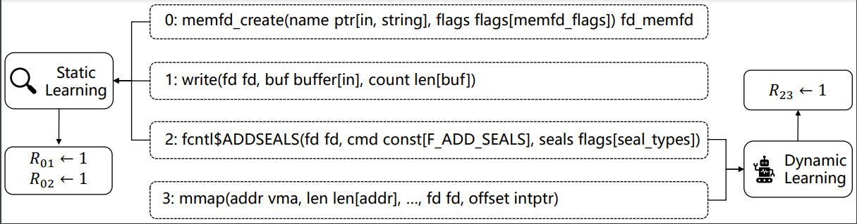
Dynamic Learning
Notes:
Here is a simple example.
With static learning, we can infer that call0 has impact on call1 and call2, also call3.
With dynamic learning, we further deduce that call also has impact on call3

Slide 23
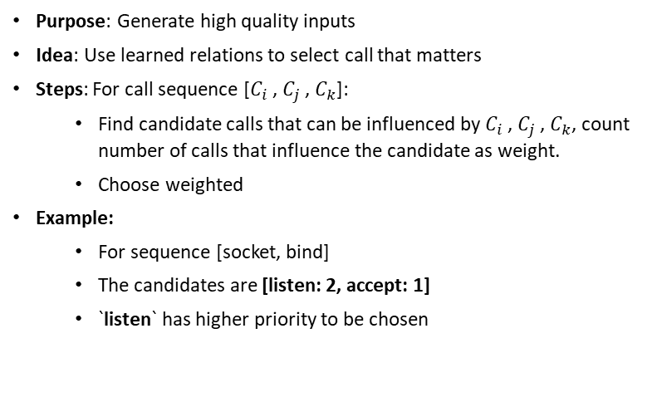
Guided Generation and Mutation
Purpose: Generate high quality inputs
Idea: Use learned relations to select call that matters
Steps: For call sequence [$C_{i}$ , $C_{j}$ , $C_{k}$]:
Find candidate calls that can be influenced by $C_{i}$ , $C_{j}$ , $C_{k}$, count number of calls that influence the candidate as weight.
Choose weighted
Example:
For sequence [socket, bind]
The candidates are [listen: 2, accept: 1]
`listen` has higher priority to be chosen
Notes:
With relation learning, we can collect more and more relations during fuzzing.
Here we talk about how to use it to improve the quality of input.
The idea here is to used learned relations to select call that really matters.
For sequence […], we first find all candidate that can … based on the learned relations. Also we need to count the number of … Then we choose call based on the weight.
For example, for sequence, socket, bind. Suppose the candidates are listen and accept. The weight of listen would be 2 because both socket and bind can have fr on it. The with accept is 1 because only socket can …
In this situation, listen has higher priority to be chosen.
In this way, we can not only choose calls that can be influenced by former calls, but also choose based on priority.

Slide 24
Revisit the Fuzzing Loop
Kernel Source
Sanitizer Configs
Corpus
Refine
Relation Learning
Feedback
Target
Kernel
Call Sequences
Syscall
Description
Mutation
Input
Executor
Relation
Gen
Call Sequence
Crash
Report
Repro
Prog
Notes:
Now, let’s go back to the workflow of kernel fuzzing.
What we really do is: first, use relation as meta information of syscalls to guide gen&mut; second, refine the meta with relation learning based on the coverage feedback.

Slide 25
Implementation
Notes:
Now, let’s talk a little about the implementation.

Slide 26
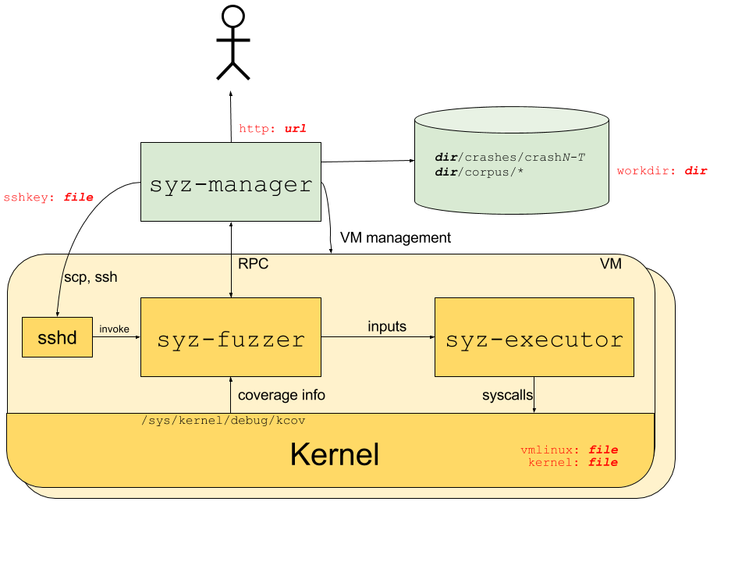
Arch of Syzkaller
Fuzzing states, e.g., coverage, corpus, choice table, are scattered across the VMs
State synchronization mechanism is inevitable, e.g., RPC
Incurs IO overheads, complexity of fuzzer design, e.g., relation learning
21
Notes:
Here is arch of Syzkaller.
It runs fuzzer inside the vm and manage the vm via syz-manager.
However, this split the fuzzing states across vms and those state need to be sync. For example, the coverage data, the corpus data are splited, Syzkaller synchronizes them via RPC.
The incurs IO overheads, but more importantly, it’s not flexible enough and imc the complexity of fuzzer design.
For example, we can not implementation relation learning easily with this arch.

Slide 27
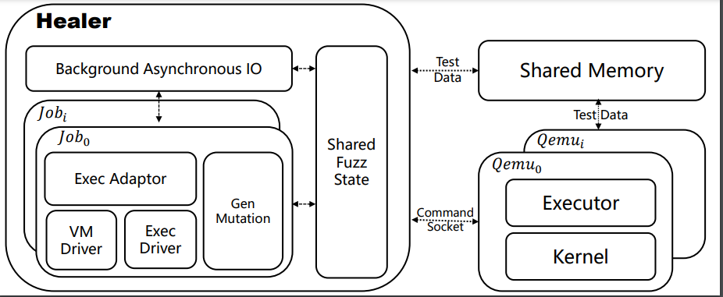
Our arch: Keep It Simple
Shared fuzzer states
Fuzzers run in host
Only executor runs in VM
Shmem communication
QEMU ivshm
Modular Design
22
Notes:
Therefore, we implemented a different arch and keep everything simple. In our design, only executor runs in the vm, and there is no manager. Fuzzer runs on the host directly and comminute with executor via shm and socket. Comm data, such as handshake, are passed though socket. The major data, such as inputs and coverage, are passed though shm. The shm itself is implemeneted with QEMU inter-vm shared memeory (IVShmem).
In this way, we can have a flexiable enough arch while keeping the IO overhead low.

Slide 28
Implementation
Implement from scratch
Written in rust, 16064 loc
Store relations in high performance `HashMap` (`Ahash`)
Leverage `tokio` to implement background IO
Read-Write lock & atomic operation, reduce sync overhead
23
Notes:
In summary, we implement the whole project from scratch with 16064 lines of rust code.
We use a high performance hashmap (Ahash) to store the learned relations and use `tokio` to impl bg IO.
We also use rw lock& atomic operation whenever we can to reduce the symc overhead.

Slide 29
Evaluation
Notes:
Now, let’s see if relation learning can really work.

Slide 30
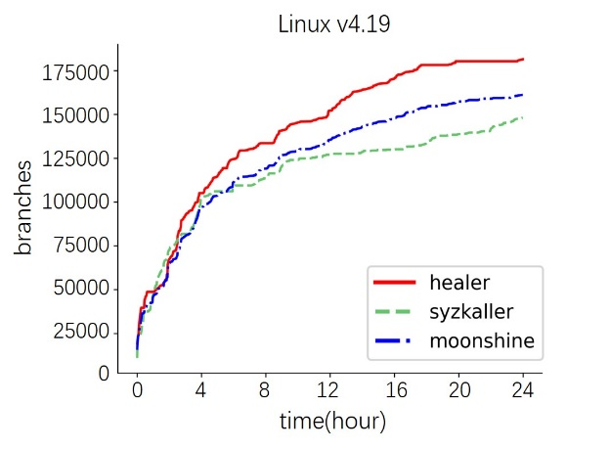
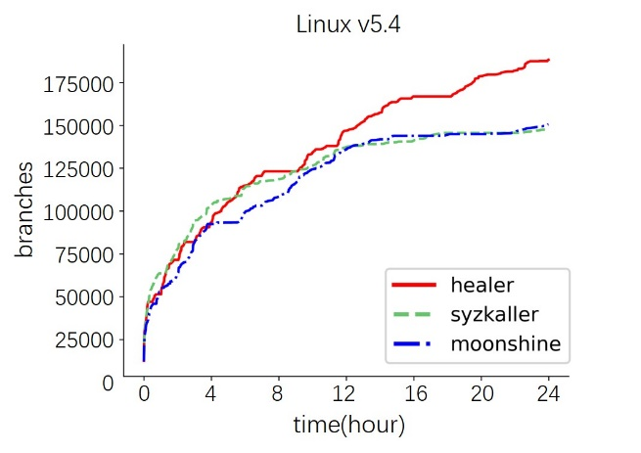
Coverage Improvement
Notes:
The first part is coverage comparison with Syzkaller and Moonshine.

Slide 31
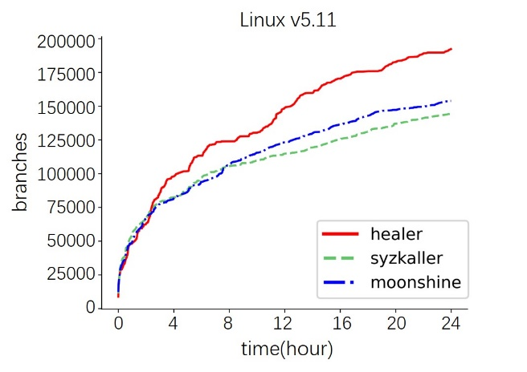
Coverage Improvement
Syzkaller: +28%, +2.2x
Moonshine: +21%, +1.8x
Syzkaller: 18+ bugs
Moonshine: 15+ bugs
The coverage improvement, bug detection improvement are obvious.
Notes:
During 24h experiment, the cov impl and the bug cap are obvious.

Slide 32
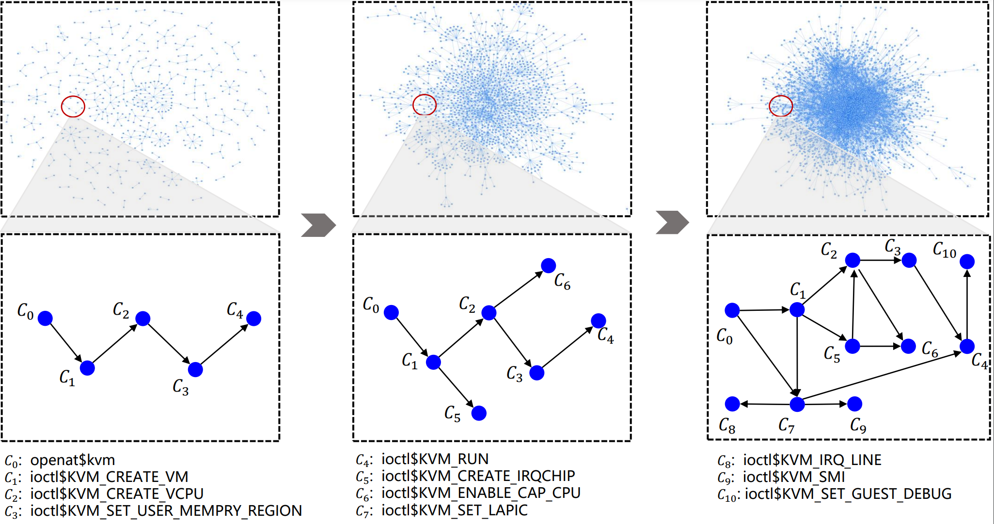
Learned Relations
Notes:
Here is an example of learned relations between KVM related syscalls.
As we can see, we’re learning a complex graph and the relations are growing step by step.

Slide 33
Long Time Fuzzing
Experiments
Fuzzing for 2 weeks, multiple versions, e.g., 4.19, 5.4, 5.6.
Found 218 bugs in total
33 are previously-unknown
In practice
Long time fuzzing in internal server
Report 20+ bug/week
3~6 confirm/week
Notes:
The most important result we think is the capability to execute the long time fuzzing.
During experiment in 2 weeks, Healer found 218 bugs in totals, 33 of them are previously-unknown.
More importantly, in practice, we’re running Healer in our internal server with limited calculation resource for long time fuzzing.
Now, we’re report 20+ bugs/week and 3~6 can be confirmed/week.
This shows Healer can really help improve the security of the kernel.

Slide 34
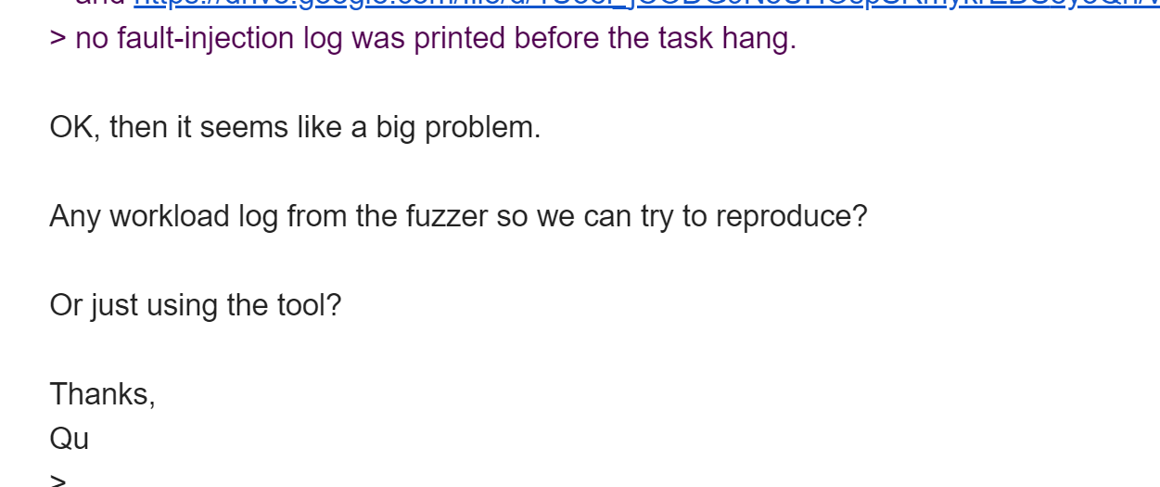
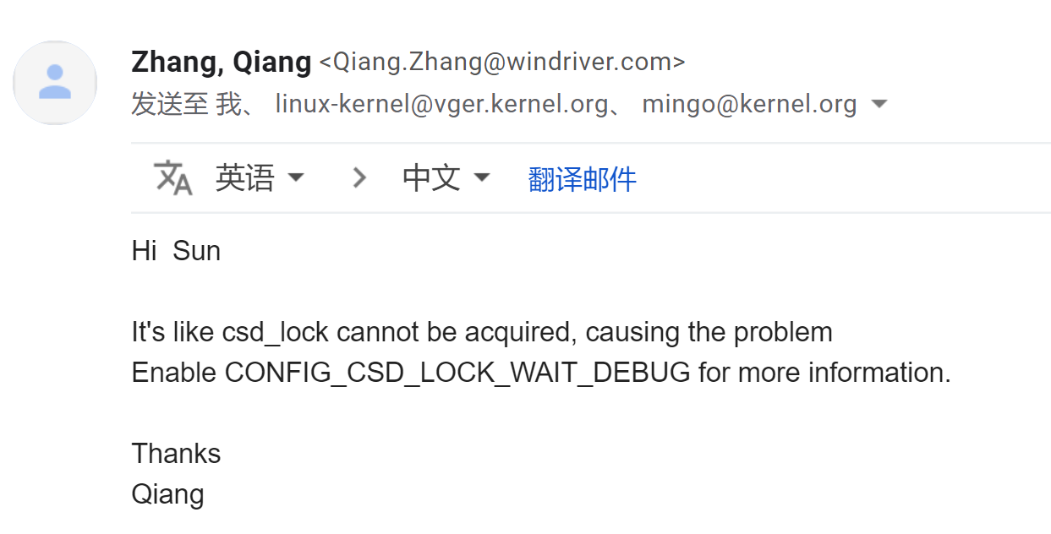
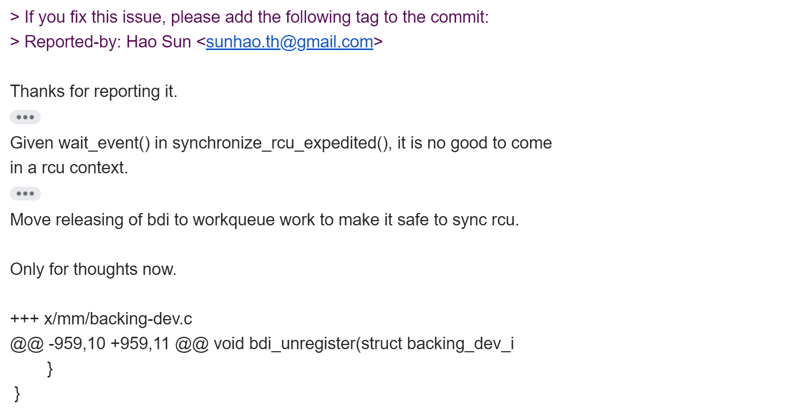
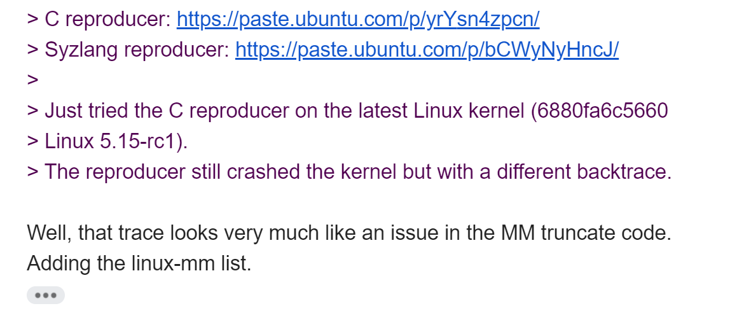
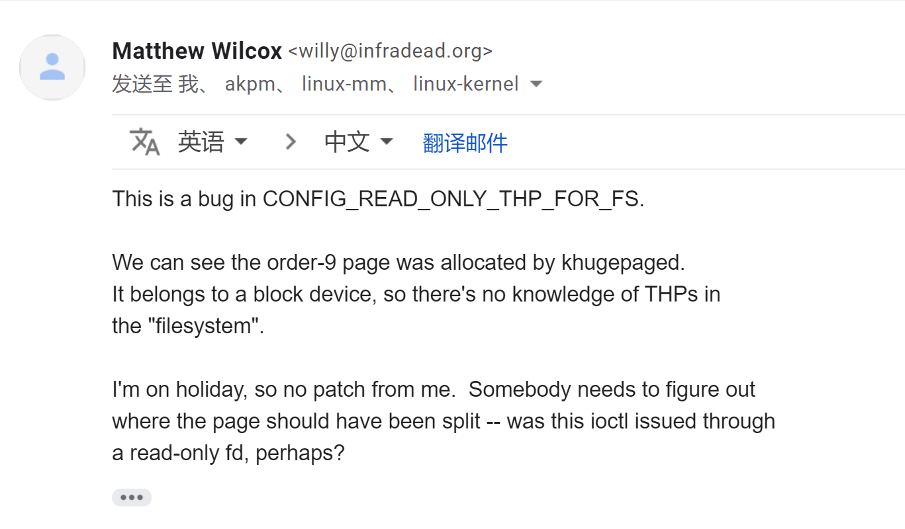
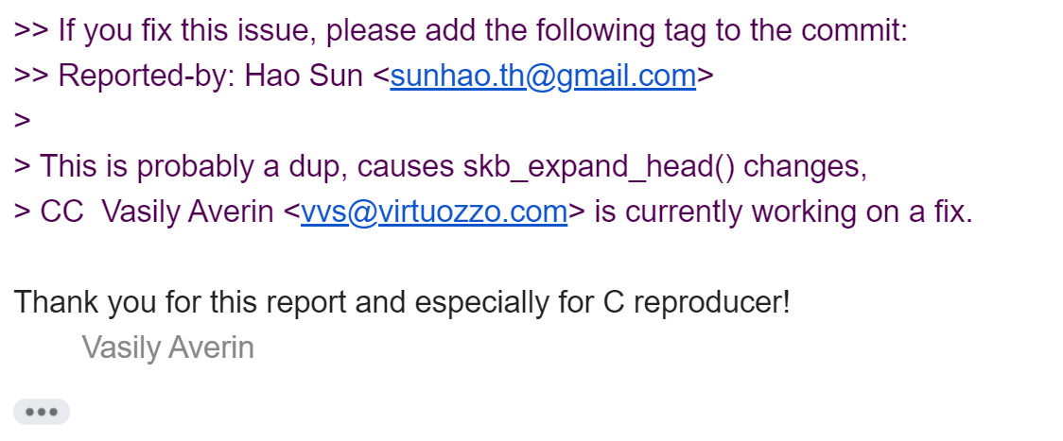
Long Time Fuzzing
Notes:
Here’re some email communication history we did with kernel maintainers.

Slide 35
Future Work
Integrate to upstream (CI)
Implement `hub` to support fuzzing on multiple hosts
Reduce the manual efforts of writing syscall description
Notes:
In the future, we need to integrate Healer to upstream and implement a hub to support fuzzing on multiple hosts like Syzkaller does now. We need to do more work to reduce the manual efforts of writing syscall descriptions.

Slide 36
Thank You

